Slide 1
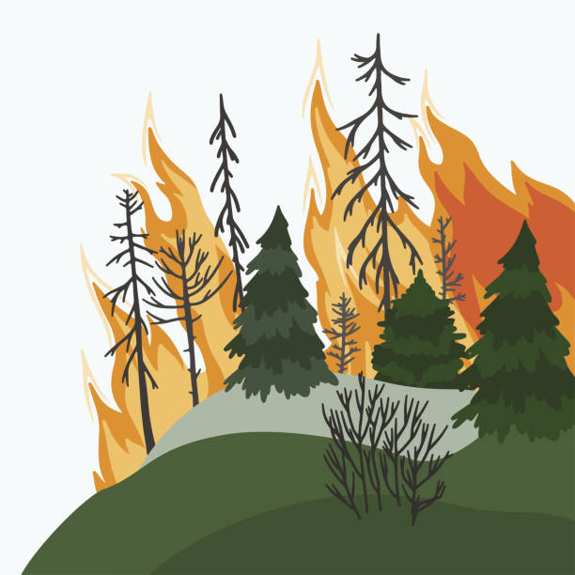
Fire Spread Simulation in Sparse Forests
Course:
Computational Methods
in Statistics B
Date:
July 1, 2025
Team: Yousef Shehade
Shada Esawi

Slide 2
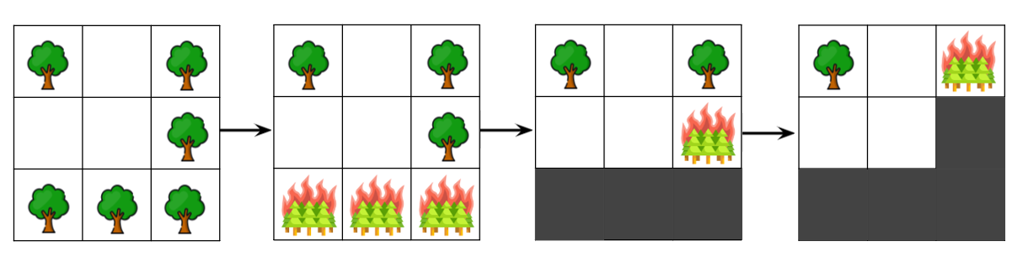
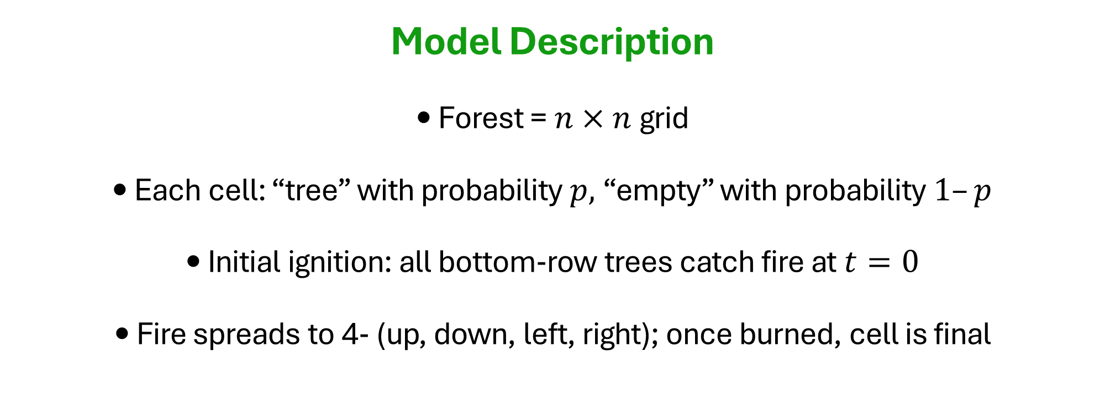
Model Description • Forest = $n×n$grid • Each cell: “tree” with probability $p,$“empty” with probability $1–p$ • Initial ignition: all bottom‐row trees catch fire at $t=0$ • Fire spreads to 4‐ (up, down, left, right); once burned, cell is final

Slide 3
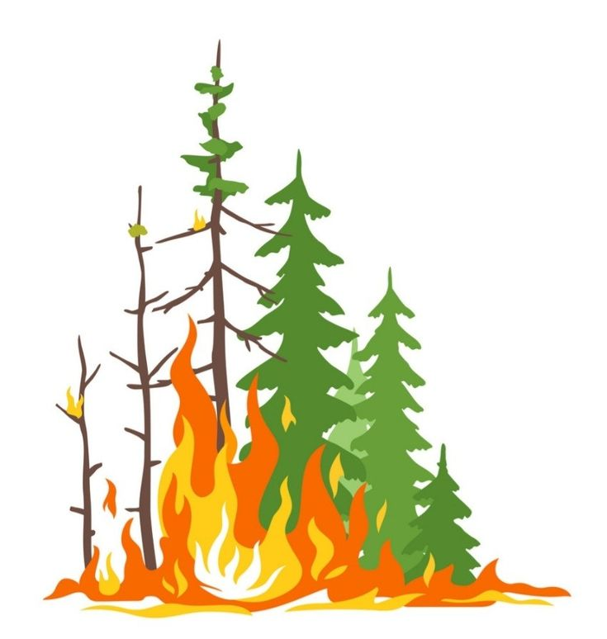
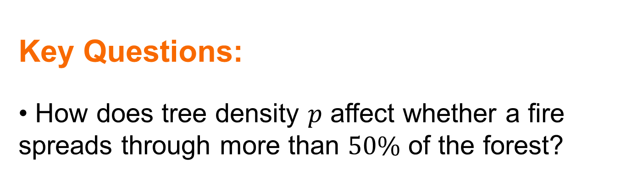


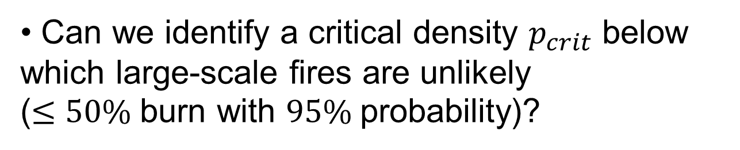
Key Questions: • How does tree density $p$ affect whether a fire spreads through more than $50\%$ of the forest?
• Can we identify a critical density $p_{crit}$ below which large-scale fires are unlikely
($≤50\%$burn with $95\%$probability)?
• How does this critical threshold change as the forest size $n$ increases?
• What density $p^{∗}$ maximizes the number of surviving trees after a fire?

Slide 4
Question 1
Write a simulation code that proceeds in time steps until no more trees are burning.
The output of one simulation: • Total number or percentage of trees burned.
• Whether more than 50% of the forest was burned.

Slide 5

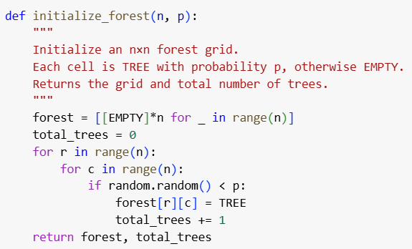
Initializing the forest
Question 1 - Solution

Slide 6
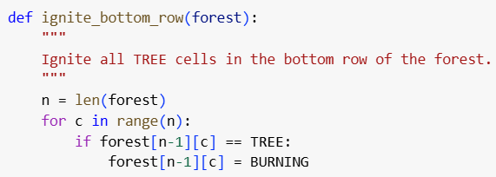
Igniting fire in bottom row

Slide 7
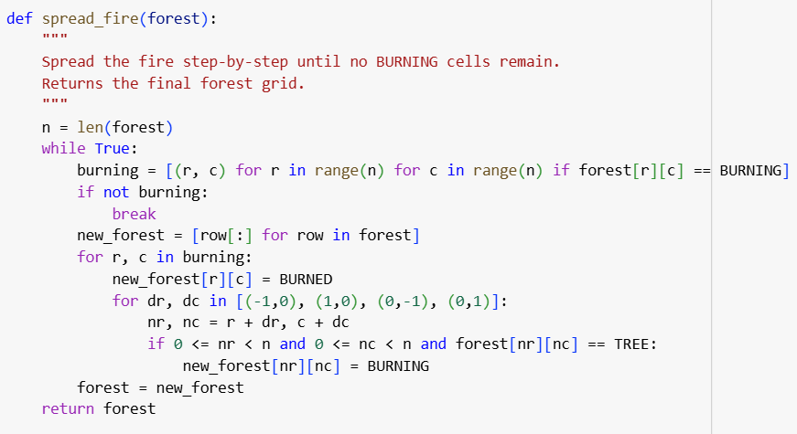
Spreading fire according to the logic

Slide 8
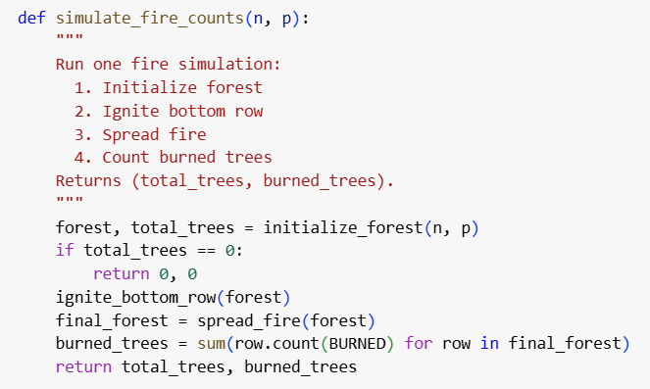
Simulating fire and counting trees

Slide 9
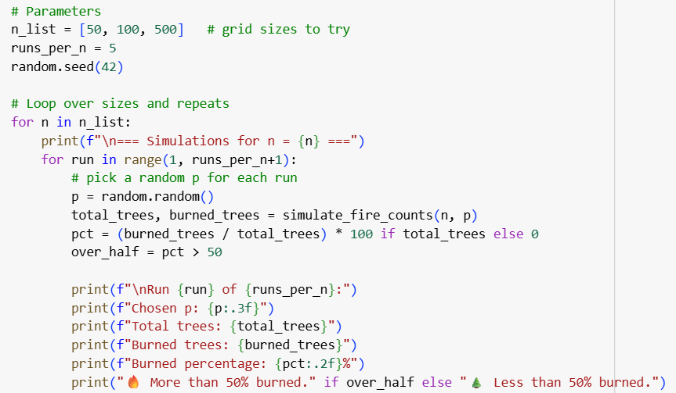
Simulations over different n

Slide 10
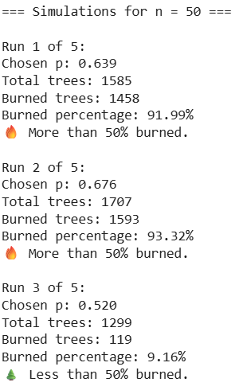
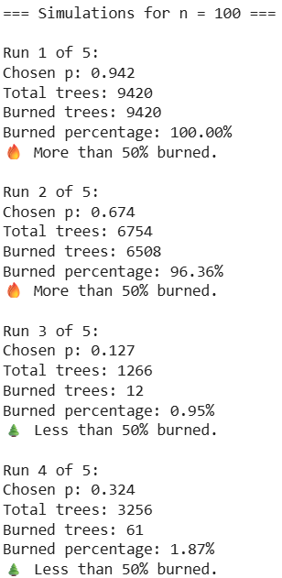
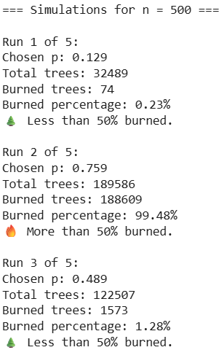
Question 1 - Results

Slide 11
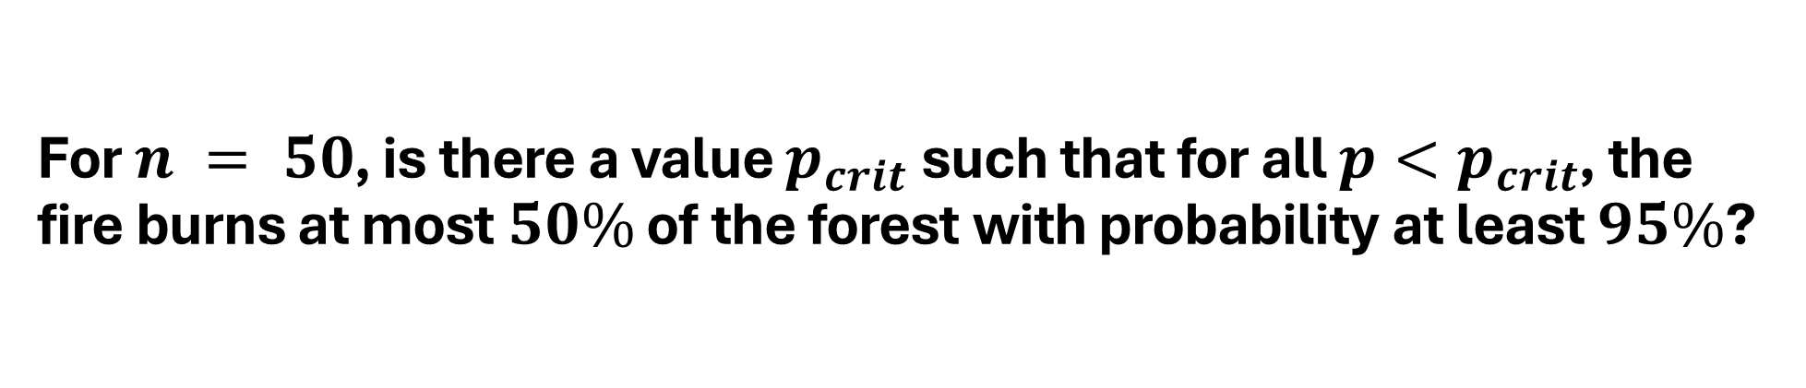
Question 2
For $n = 50$, is there a value $p_{crit}$such that for all $p<p_{crit}$, the fire burns at most $50\%$ of the forest with probability at least $95\%$?

Slide 12
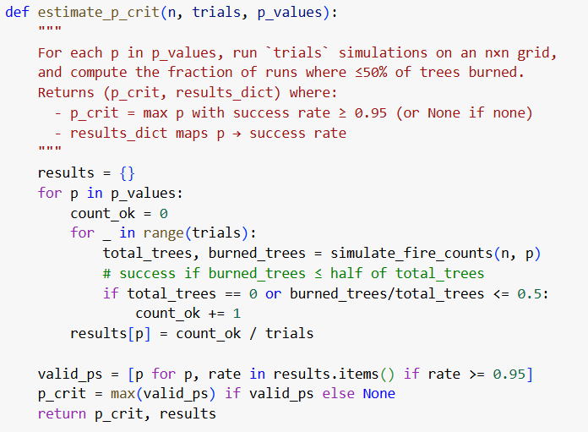
Question 2 - Solution

Slide 13
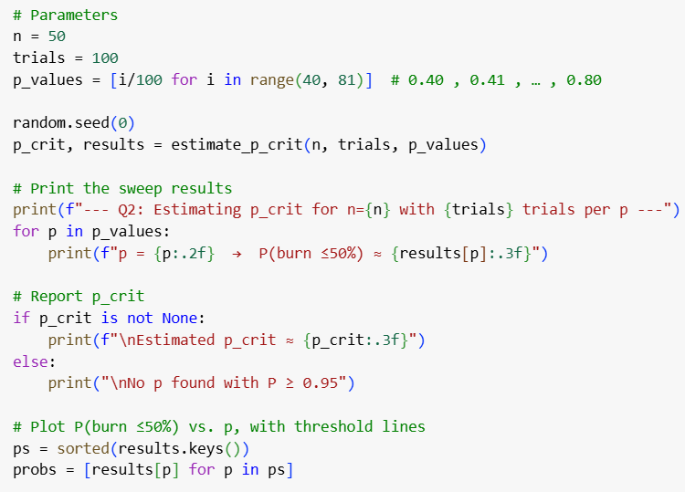
Question 2 - Solution

Slide 14
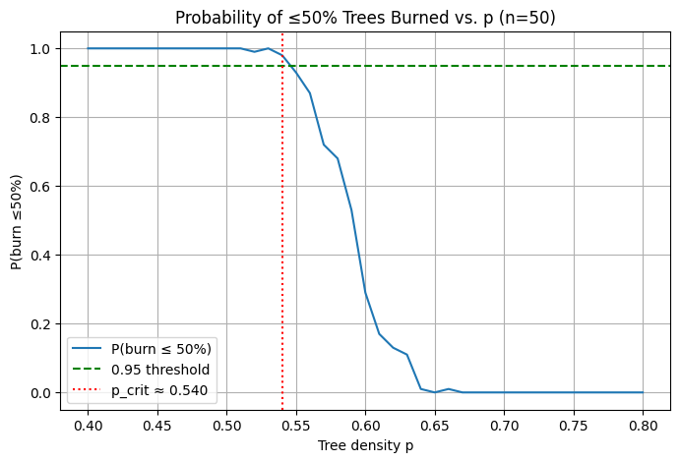
Question 2 - Results

Slide 15
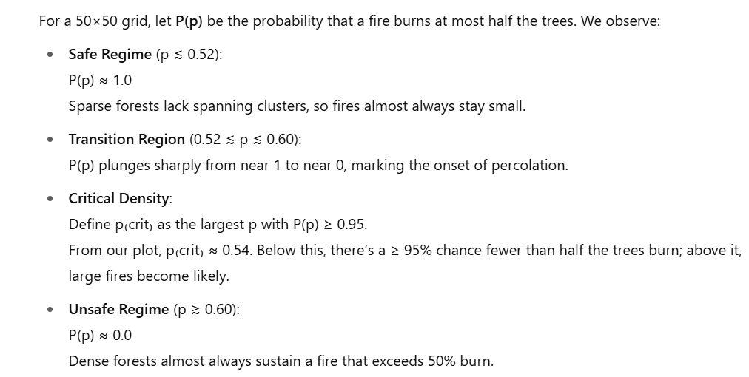
Question 2 - Conclusions

Slide 16
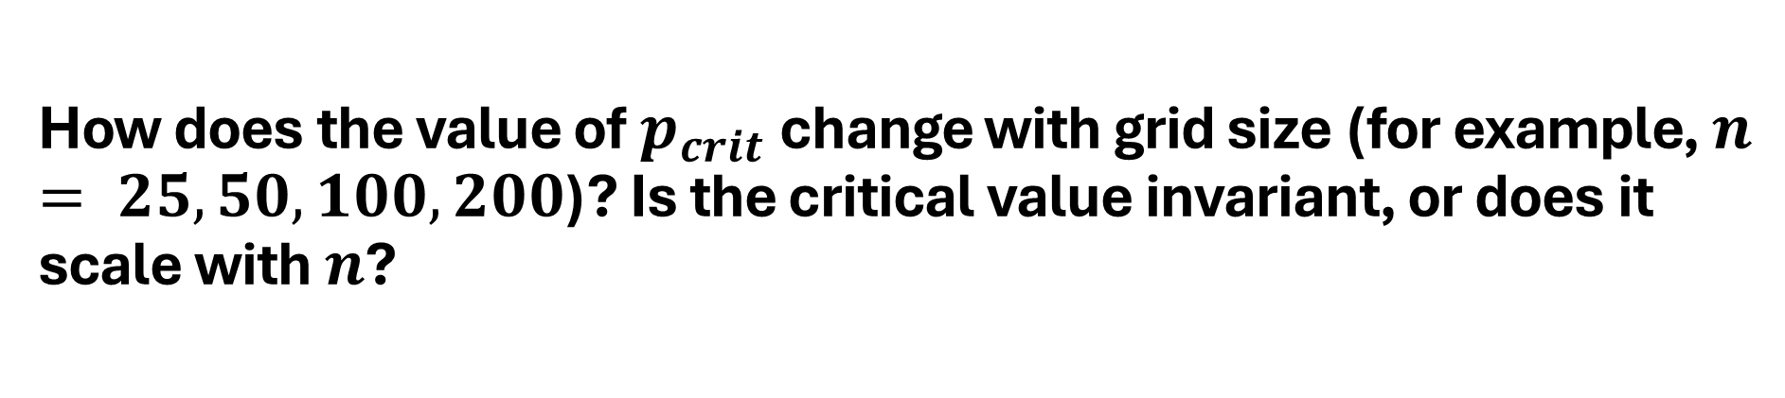
Question 3
How does the value of $p_{crit}$change with grid size (for example, $n = 25, 50, 100,200$)? Is the critical value invariant, or does it scale with $n$?

Slide 17
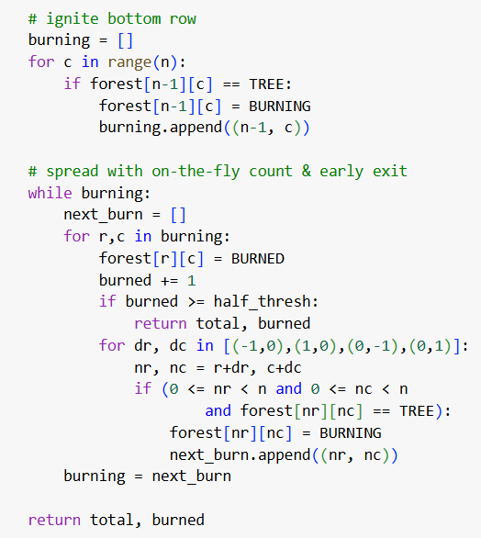
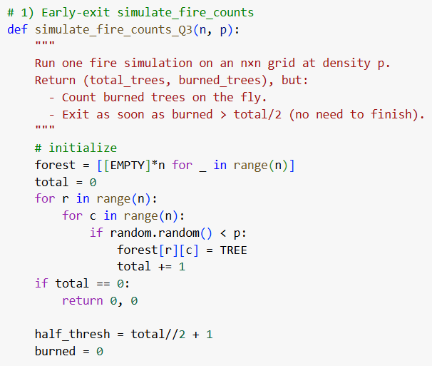
Question 3 - Solution

Slide 18
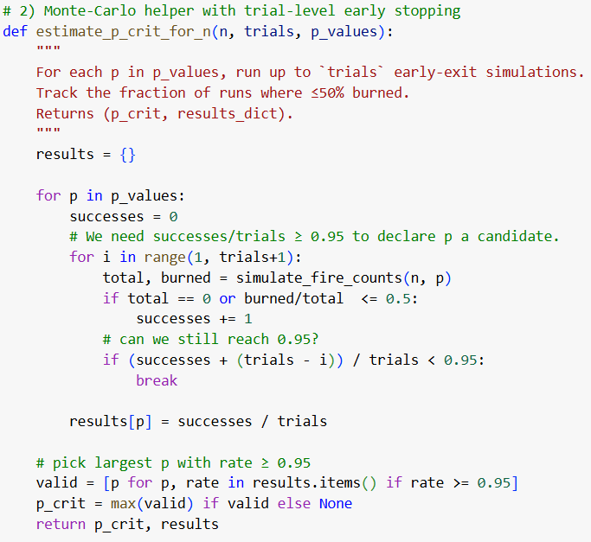
Question 3 - Solution

Slide 19
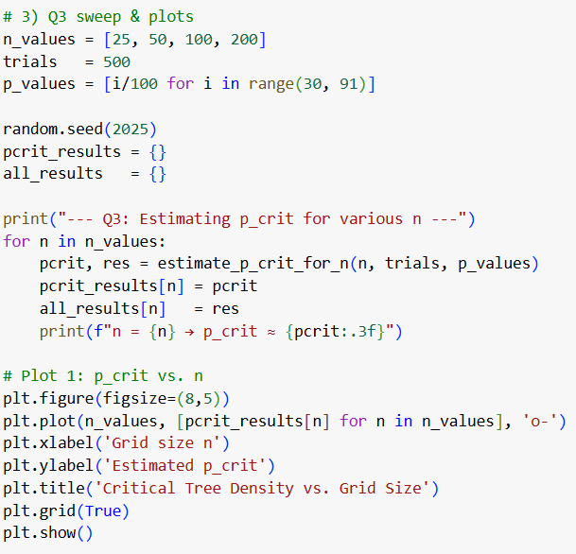
Question 3 - Solution

Slide 20
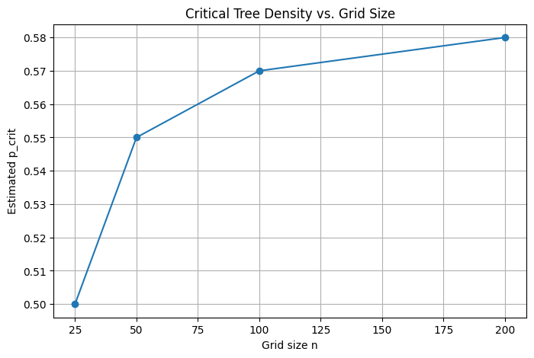
Question 3 - Results

Slide 21
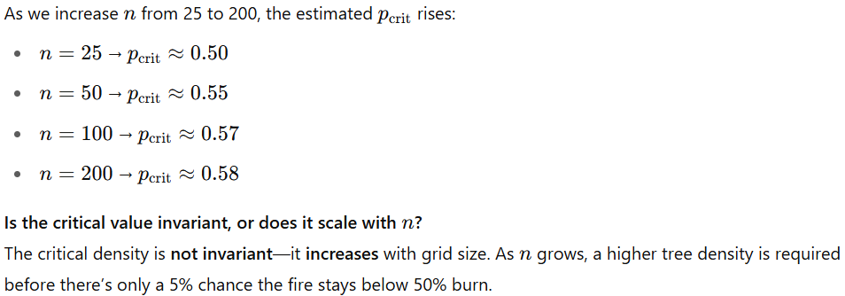
Question 3 - Conclusions

Slide 22
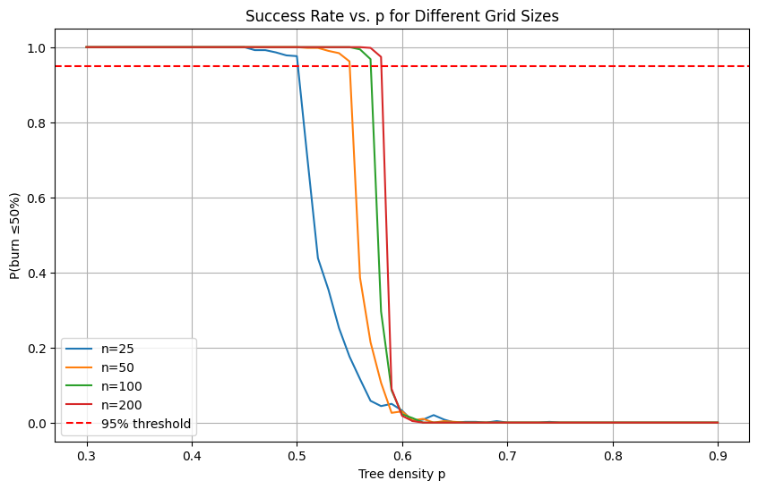
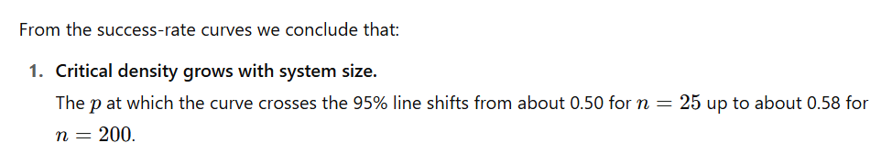
Question 3 - Conclusions

Slide 23
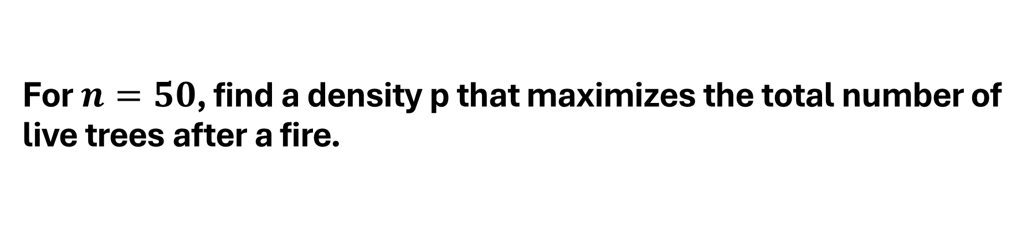
Question 4
For $n=50$, find a density p that maximizes the total number of live trees after a fire.

Slide 24
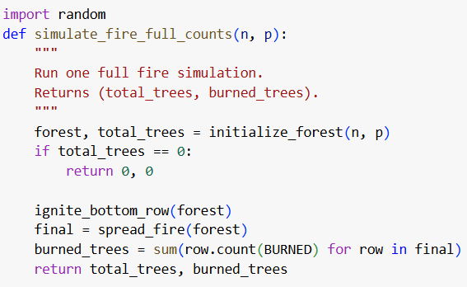
Question 4 - Solution

Slide 25
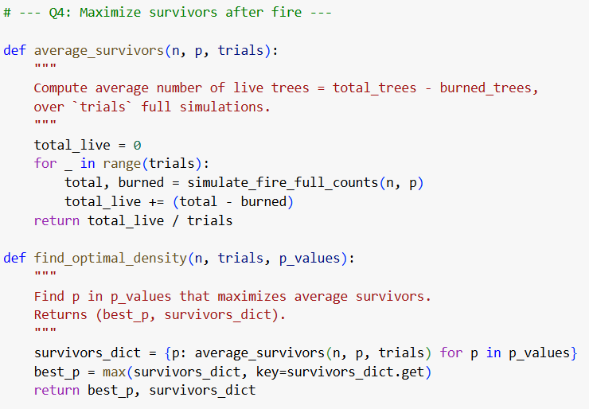
Question 4 - Solution

Slide 26
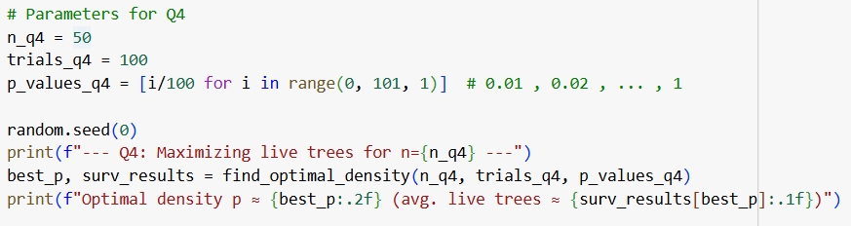
Question 4 - Solution

Slide 27
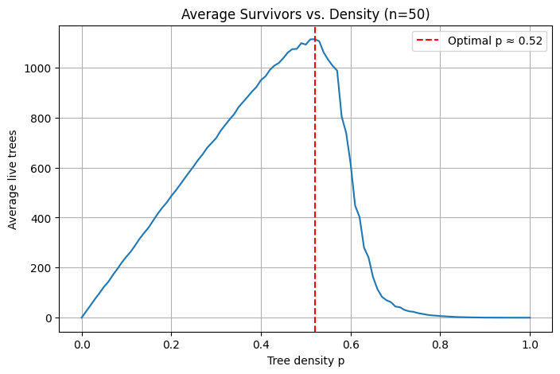
Question 4 - Results

Slide 28
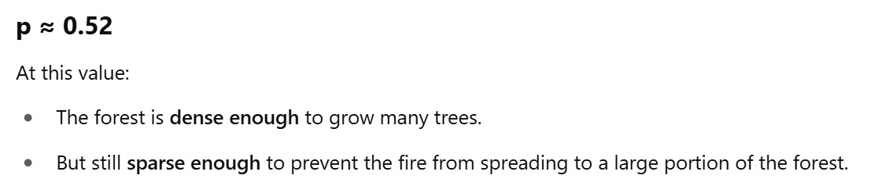
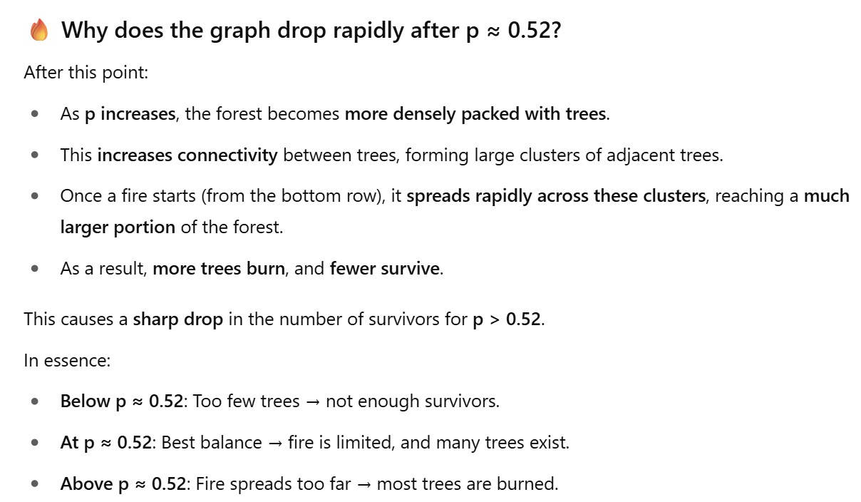
Question 4 - Conclusions

Slide 29
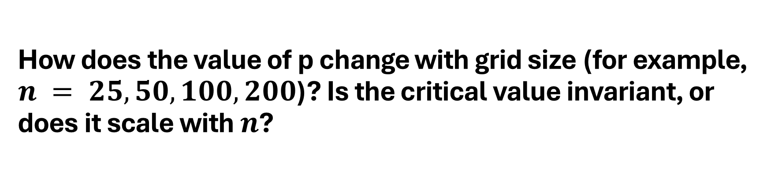
Question 5
How does the value of p change with grid size (for example, $n = 25, 50, 100,200$)? Is the critical value invariant, or does it scale with $n$?

Slide 30
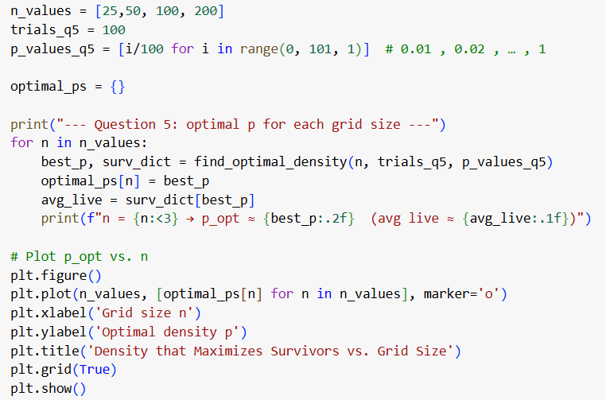
Question 5 - Solution

Slide 31
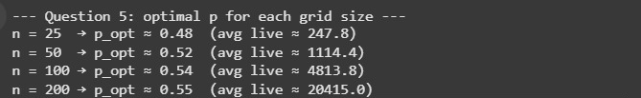
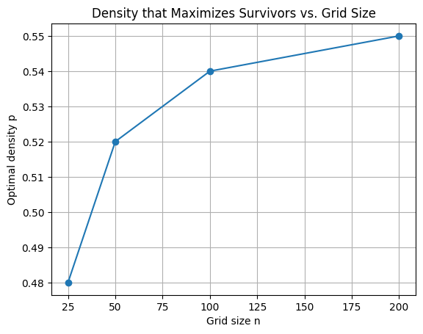
Question 5 - Results

Slide 32
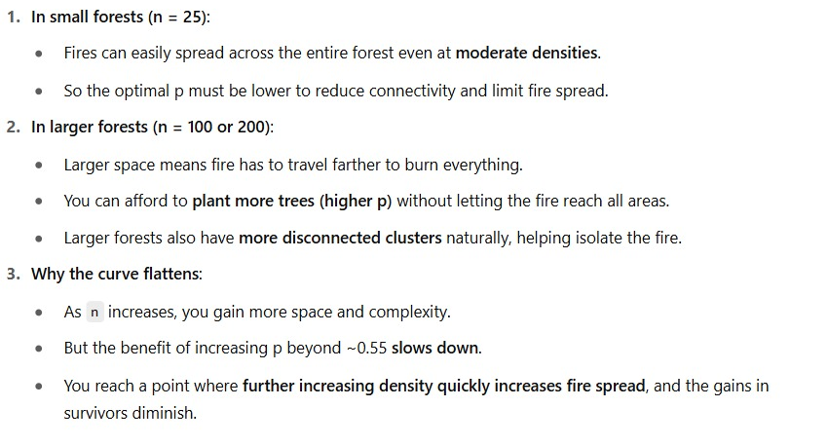

Question 5 - Conclusions

Slide 33

Thank You All For Your Attention🔥🔥

